Slide 1

by:
Ajirinsola Oluwafolakemi Ayomide
ayofolakemi01@gmail.com
A
capstone project
on:
AirQo African Air Quality Prediction

Slide 2
Implementation
Introduction
Air pollution is the world’s largest environmental health risk, contributing to 7 million premature deaths globally each year, and poor people in developing countries are the most heavily affected.
Objective: to create a machine learning model to estimate PM2.5 levels from satellite observations based on Aerosol Optical Depth (AOD) for eight cities in seven African countries (Lagos, Accra, Nairobi, Yaounde, Bujumbura, Kisumu, Kampala, and Gulu)
Importance: The machine learning models can be used to estimate pollution levels over large areas to help develop interventions such as vulnerability risk profiles for urban spaces, health preservation and environmental protection for affected populations, as well as community empowerment, and climate change mitigation.

Slide 3
Implementation
Problem statement
Air pollution causes 7 million premature deaths annually, with developing countries being the hardest hit.
High costs hinder the implementation of IoT sensor networks for air quality monitoring in these regions.
This project aims to use machine learning to estimate PM2.5 levels in eight African cities so as to provide a cost-effective solution for monitoring air quality and supporting health and environmental interventions.

Slide 4
Implementation
Data collection
Data source:
Sentinel 5P satellite
Method of collection:
Data was collected from satellite observations based on Aerosol Optical Depth (AOD) for eight cities in seven African countries - Lagos, Accra, Nairobi, Yaounde, Bujumbura, Kisumu, Kampala, and Gulu

Slide 5
Methodology
Data Inspection
Data cleaning
Important library were imported
The dataset was imported
The data was inspected by checking:
The shape (8071, 80)
The info
Descriptive analysis
Missing value (39.12%)
The missing value were cleaned
The columns were changed to the correct data type
The irrelevant columns were dropped

Slide 6
Implementation
Dealing with missing values
Removing columns that contains over 90% missing values and above
Replacing missing values through interpolation
Filing missing values in non-numerical columns with the mode (most frequent value)

Slide 7
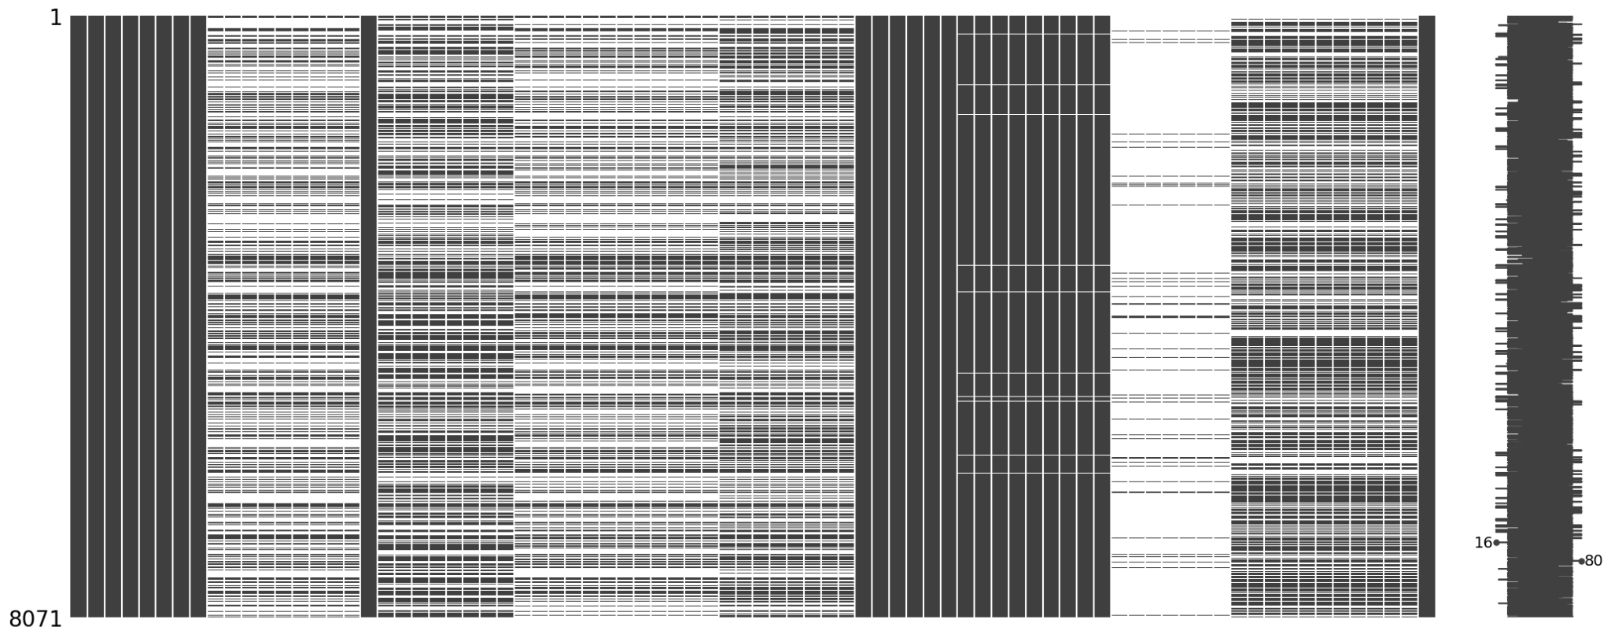
Exploratory data analysis
Visualizing missing value using missingno.

Slide 8
Data preprocessing
Machine learning
The data set was scaled using Standard Scaler.
Scaling was done to prevent the model from being biased
Pre-model selection:
Data set was splitted into x test, x train, y test and y train.
X train and y train was fitted into the model

Slide 9
Machine learning
Model selection:
The model selected were: Random Forest Regressor and decision tree Regressor.
These models were selected because it is a regression task.

Slide 10
Model evaluation
Random Forest Regressor:
Testing score: 0.55
Mean square error 200.45
Mean absolute error 6.21
Root mean squared error 14.16
Decision Tree Regressor:
Testing score: 0.31
Mean square error 308.51
Mean absolute error 8.42
Root mean squared error 17.56

Slide 11
Result and discussion
The Root mean squared error for the Random Forest Regressor is 14.16
The Root mean squared error for the Decision Tree Regressor is 17.56

Slide 12
Thank you for listening
max growth

